Slide 1
MP3 PLAYER PYTHON/TKINTER

Slide 2
INTRODUCTION
About the project & how to run the MP3 PLAYER code:
This is a Python project with a GUI made with Tkinter. We created an MP3 player using Visual Studio Code with necessary extension Python & Pylance.
Requirements:
pip install tk
pip install ttkthemes
pip install pygame
pip install mutagen

Slide 3
PROJECT COMPONENT
01
02
03
Main.py
Img folder
Config.cfg
A file contains Python code.
A folder contains all images of the project.
A file that saves your volume settings.

Slide 4
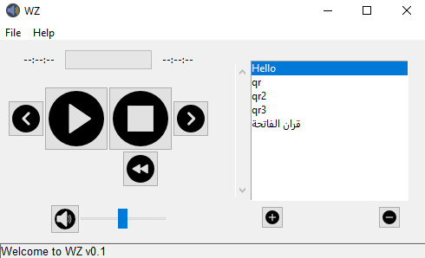
PROGRAM MAIN SCREEN
Contains:
Play / pause / stop / reset file / skip forward & backward / reset playlist buttons.
Progress bar with timer.
Volume scale & mute button.
Playlist section with add & remove file.
File and Help navbar.
Footer bar.

Slide 5
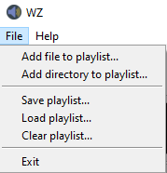

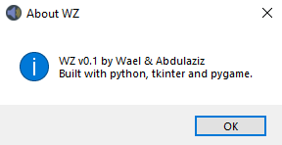
FILE AND HELP NAVBAR
Contains:
File
Add file / Add directory playlist.
Save / Load / Clear playlist (.mldpl).
Exit program.
Help
About window.

Slide 6
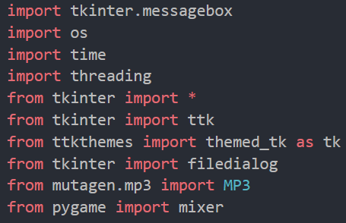
IMPORTS
Contains:
from tkinter import *: Python with tkinter is the fastest and easiest way to create the GUI applications.
import os: Provides functions for interacting with the operating system.
import time: It allows functionality like getting the current time, pausing the Program from executing, etc.
import threading: provides a very simple and intuitive API for spawning multiple threads in a program.
from pygame import mixer: It includes computer graphics and sound libraries designed to be used with the Python programming language.

Slide 7
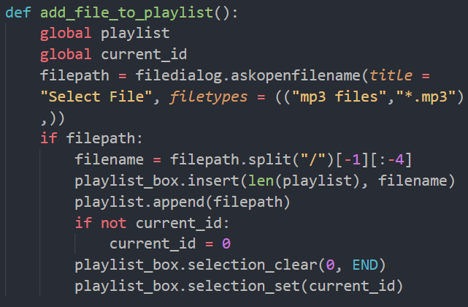
ADD FILE TO PLAYLIST
This function let us browse the file system to add audio to the playlist.
filedialog is used to display an open file dialog.
The askopenfilename() is used to return the file name that you selected.
filename = filepath.split("/")[-1][:-4] means it is selected by splitting the file path by the(/) and taking only the filename.
append() method appends an element to the end of the list.

Slide 8
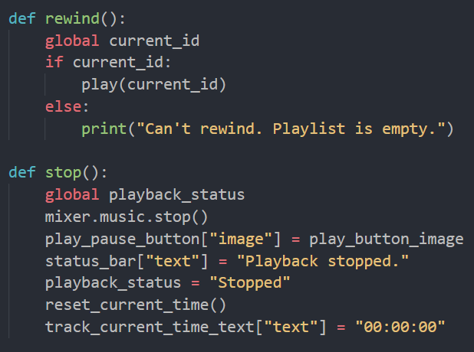
REWIND & STOP
First function:
Rewind to the beginning of the audio and play.
Main code:
if current_id:
play(current_id)
Second function:
Stops audio playback.
Main code:
mixer.music.stop()
reset_current_time()

Slide 9
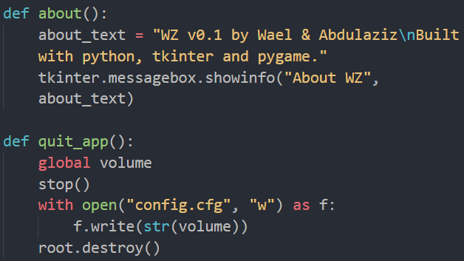
ABOUT & QUIT APP
First function:
Opens info box.
Main code:
tkinter.messagebox.showinfo(,)
Second function:
Stop audio and save volume in config.cfg file then closes the app.

Slide 10
THANK YOU
For Your Attention!

